Slide 1
Graph
Prepared By:
Afsana Begum
Lecturer,
Software Engineering Department,
Daffodil International University.

Slide 2
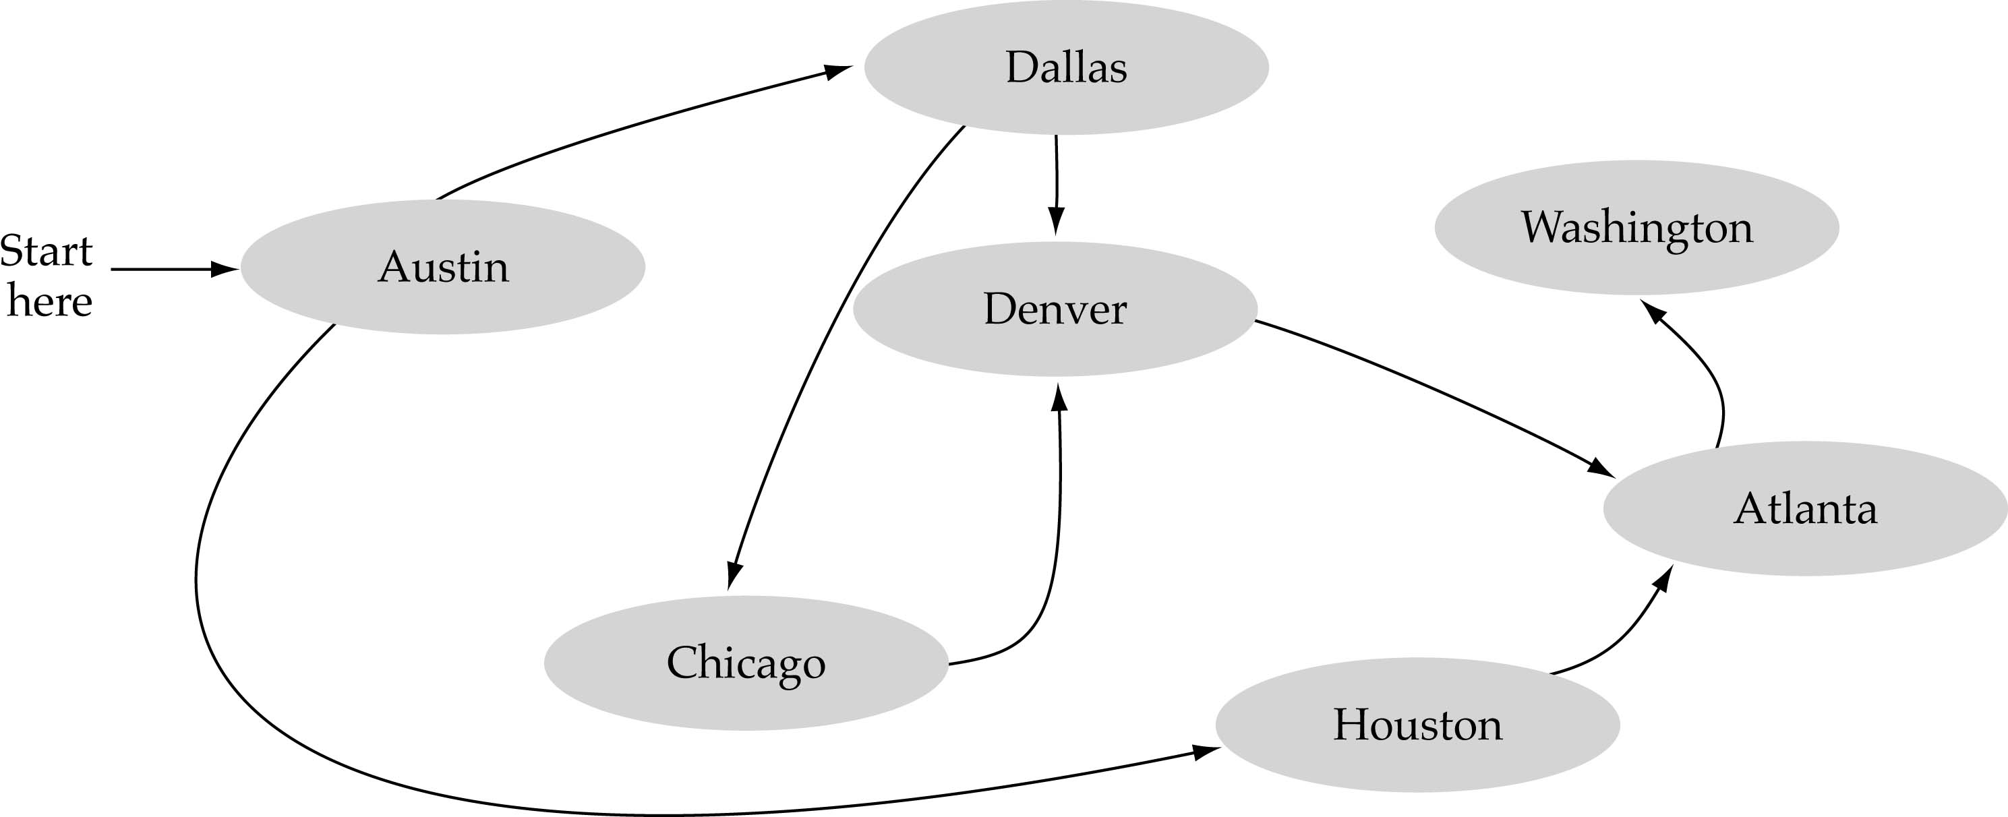
What is a graph?
A data structure that consists of a set of nodes (vertices) and a set of edges that relate the nodes to each other
The set of edges describes relationships among the vertices

Slide 3
What is a graph?
Graphs are mathematical concepts that have found many uses in computer science. Graphs come in many different flavors, many of which have found uses in computer programs. Some flavors are:
Simple graph
Undirected or directed graphs
Cyclic or acyclic graphs
labeled graphs
Weighted graphs
Infinite graphs

Slide 4
Formal definition of graphs
A graph G is defined as follows:
G=(V,E)
V(G): a finite, nonempty set of vertices
E(G): a set of edges (pairs of vertices)

Slide 5
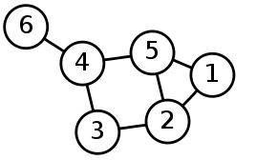
Simple Graph
Has the following parts.
The underlying set for the Verticies set is the integers.
The Vertices set = {1,2,3,4,5,6}
The Edge set = {(6,4),(4,5),(4,3),(3,2),(5,2),(2,1),(5,1)}

Slide 6
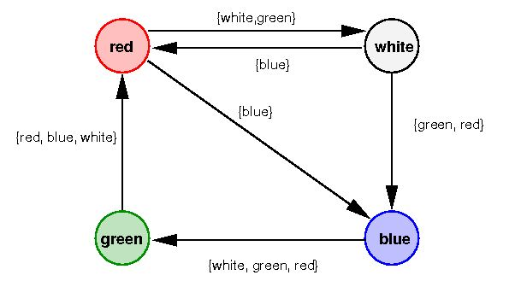
Edge labeled Graphs OR Vertex labeled Graphs
Here we have the following parts.
The underlying set for the the Vertices set is Color.
The underlying set for the edge labels is sets of Color.
The Vertices set = {Red,Green,Blue,White}
The Edge set = {(red,white,{white,green}) ,(white,red,{blue}) ,(white,blue,{green,red}) ,(red,blue,{blue}) ,(green,red,{red,blue,white}) ,(blue,green,{white,green,red})}

Slide 7
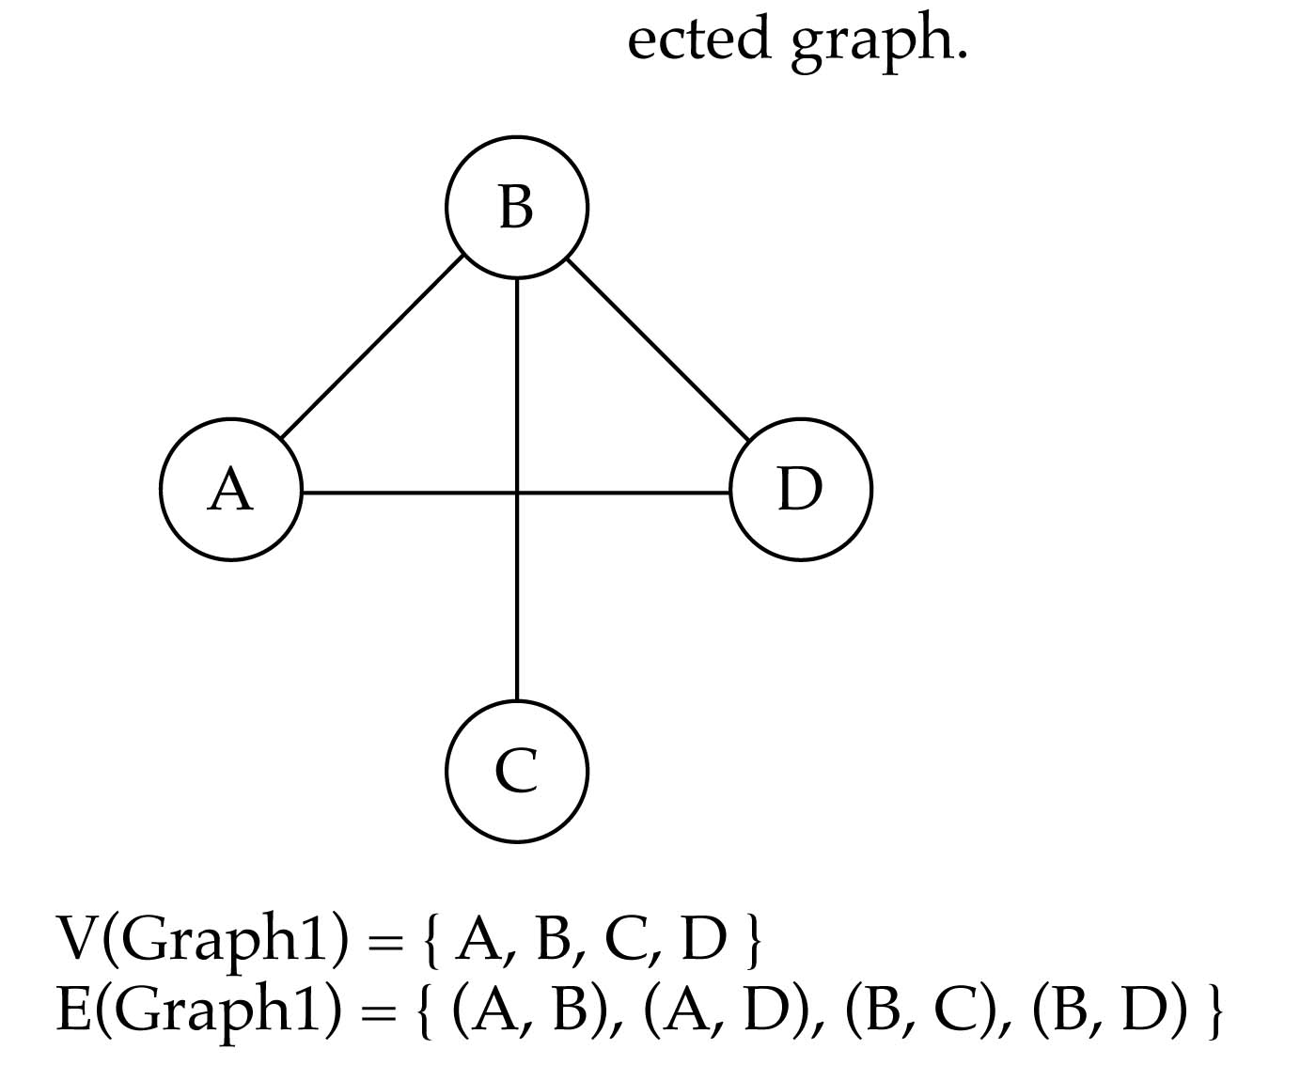
Undirected graphs
When the edges in a graph have no direction, the graph is called undirected

Slide 8
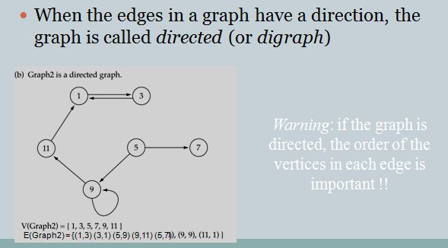
Directed Graph

Slide 9
Cyclic or acyclic graphs
A cyclic graph is a directed graph with at least one cycle. A cycle is a path along the directed edges from a vertex to itself. The vertex labeled graph above as several cycles. One of them is 2 » 4 » 5 » 7 » 6 » 2

Slide 10
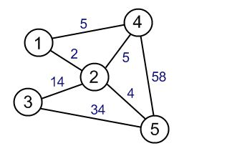
Weighted graphs
Here we have the following parts.
The underlying set for the the Vertices set is Integer.
The underlying set for the weights is Integer.
The Vertices set = {1,2,3,4,5}
The Edge set = {(1,4,5) ,(4,5,58) ,(3,5,34) ,(2,4,5) ,(2,5,4) ,(3,2,14) ,(1,2,2)}

Slide 11
Degree
The degree of a vertex is the number of edges incident to that vertex.

Slide 12
undirected graph
degree
3
0
0
2
1
2
3
1
2
3
3
3
3
4
5
6
3
3
1
G1
1
G2
1
1
0
in:1, out: 1
directed graph
in-degree
out-degree
1
in: 1, out: 2
2
in: 1, out: 0
G3

Slide 13
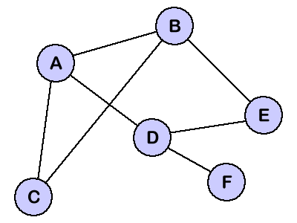
Problem 1 Consider the (undirected) graph G in Figure. i.Describe G formally in terms of its set V of nodes & E of edges ii. Find the degree of each node
Solution:
i. V(G)={A,B,C,D,E,F}
E(G)={(A,B),(A,C),(A,D),(B,C),(B,E),(D,E),(D,F)}
Degree of A=3
Degree of B=3
Degree of C=2
Degree of D=3
Degree of E=2
Degree of F=1

Slide 14
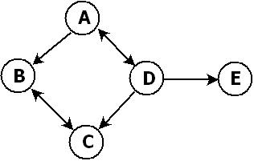
Problem 2 Consider the (directed) graph G in Figure. i.Describe G formally in terms of its set V of nodes & E of edges ii. Find the degree of each node
Solution:
V(G)={A,B,C,D,E}
E(G)={(A,B),(D,A),(A,D),(B,C),(C,B),(D,E),(D,C)}
Degree of A: in-1, out-2
Degree of B: in- 2, out-1
Degree of C: in-2 , out-1
Degree of D: in-1 , out-3
Degree of E: in-1 , out-0

Slide 15
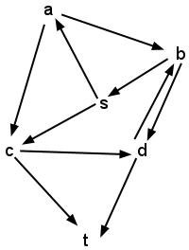
Directed Graph Path Calculation
Example:
Possible path to reach from a to s
is :{a,b,s}
Possible path to reach from c to d
is : {c,d}
Possible path to reach from b to c
is : {b,s,c},{b,s,a,c}
Endage(a):1
Outdage(a):2
Endage(b):2
Outdage(b):2

Slide 16
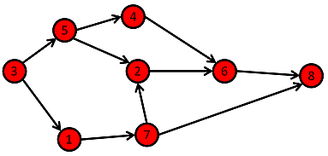
Problem 3 Consider the (directed) graph G in Figure. i. Find all the sample paths from 5 to 6 ii. Find the endage(5) and outdage(5)
Solution:
All sample path from 5 to 6 are:
{5,4,6},{5,2,6}
Endage(5) : 1
Outdage(5): 2

Slide 17
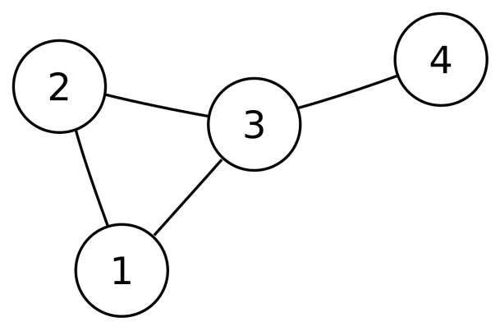
Problem 4 Consider the (undirected) graph G in Figure. i. Find all the sample paths from 1 to 4 ii. Find the endage(3) and outdage(3)
Solution:
i. All sample path from 1 to 4 are:
{1,2,3,4},{1,3,4}
ii. No specific endage and outdage as it is undirected graph.
Degree is = 3

Slide 18
Assignment 1
Describe Shortest path algorithm technique (any one) with example.

Slide 19
Thank you

